Slide 1
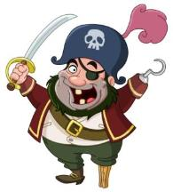
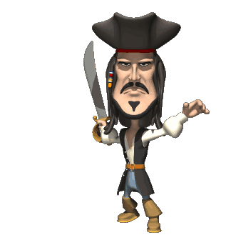
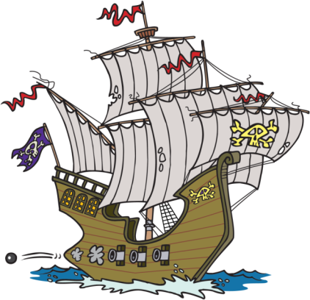
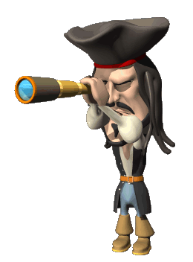
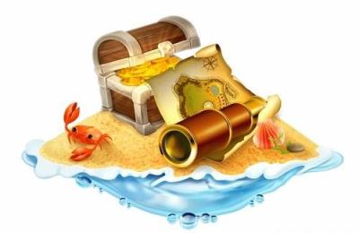
Battleship
Щекино 2016г

Slide 2

Choose and shoot
1 | 2 | 3 | 4 | 5
6 | 7 | 8 | 9 | 10
11 | 12 | 13 | 14 | 15
16 | 17 | 18 | 19 | 20
21 | 22 | 23 | 24 | 25

Slide 3

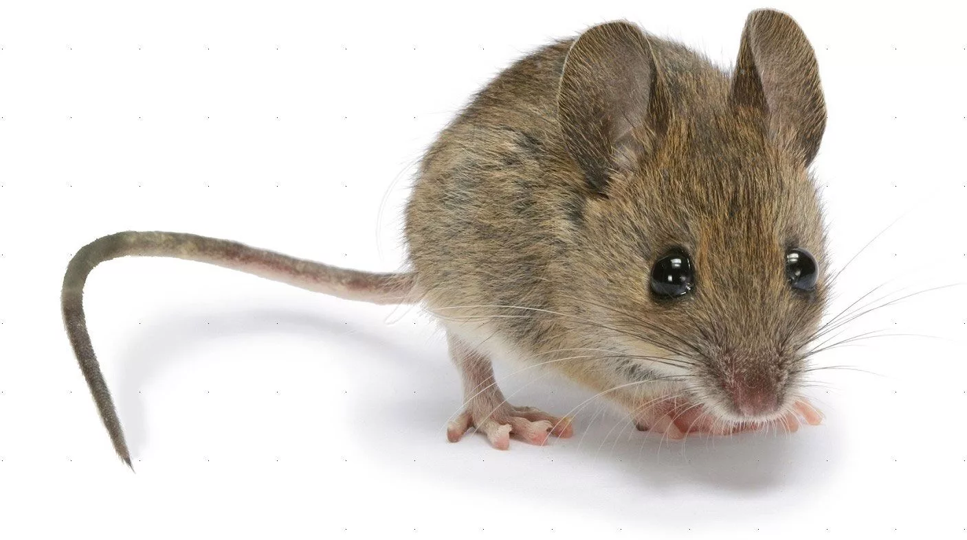
What animal is it?
It’s a small animal. It has got big ears, short legs and a long tail. It is grey. It likes cheese. It doesn’t like cats.

Slide 4


Slide 5
Match.
1 elephant | A big mouth
2 crocodile | B big eyes
3 rabbit | C long tail
4 kangaroo | D big ears
5 frog | E long ears
1 D 2 A 3 E 4 C 5 B

Slide 6
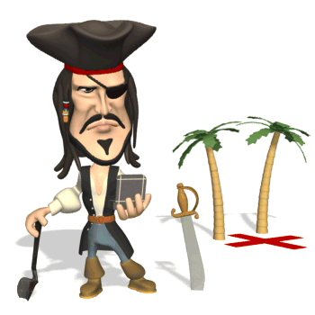

Slide 7
Fill in have got / has got
have got
1.We _____________________books.
2.I______________________a nice dog.
have got
has got
3. He_______________________two legs.
has got
4. Olga_________________________blond hair.
5. My friends ________________black pens.
have got

Slide 8
Write the plural
sheep -
child -
foot -
man -
sheep
children
feet
men

Slide 9
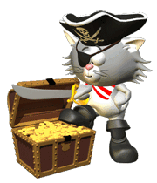

Slide 10


Slide 11
Guess the words.
oByd
adeH
tuhoM
Body
Head
Mouth

Slide 12


Slide 13
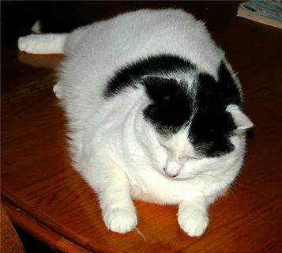
Fill in: fat, long, cat, meat, white
This is my ____________, Pushok. He is black and_______________. Pushok has got a _________________body, small ears and a__________________tail. He likes milk and____________________.
cat
white
fat
long
meat

Slide 14
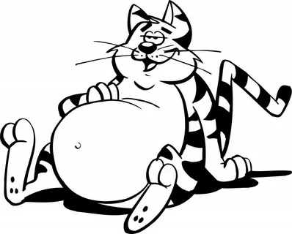
Name 10 animals
Текст вопроса

Slide 15
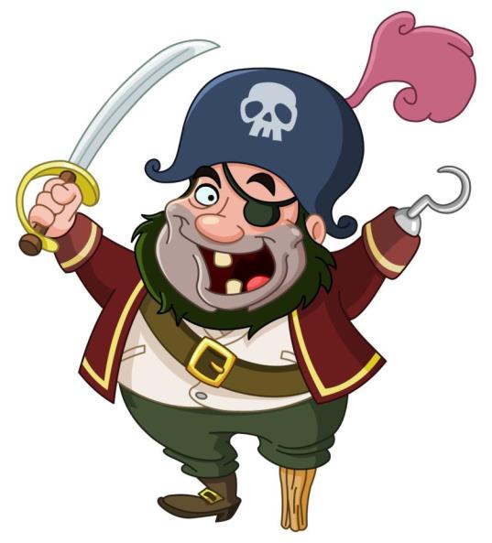

Slide 16
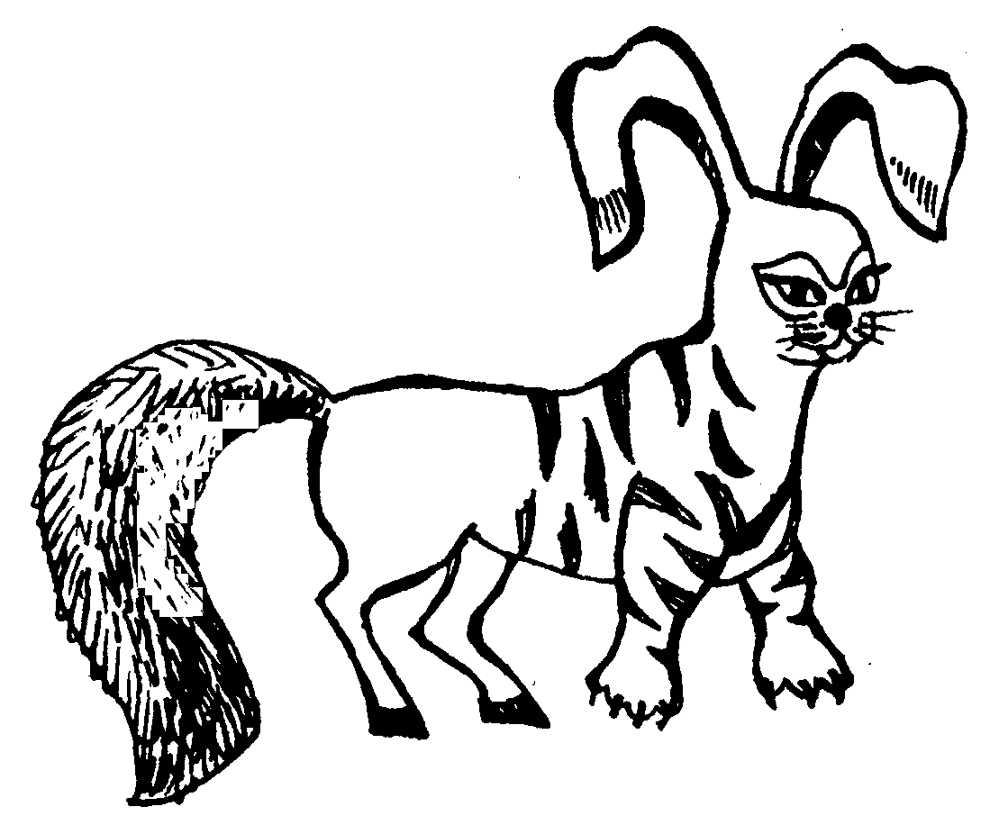
Yes / No
Has it got a long tail?
Has it got short ears?
Has it got four legs?
Has it got a fat body?

Slide 17
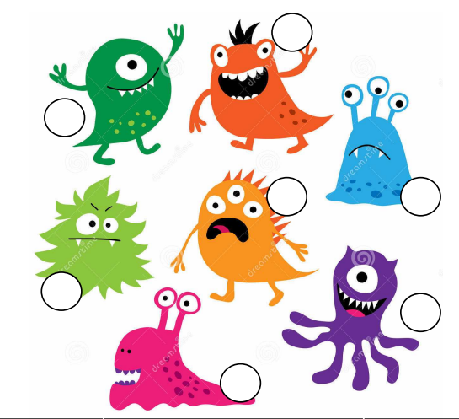
Find the monster
Текст вопроса
I'm Trillian.
I've got three eyes. I've got two legs.
I haven't got any teeth.

Slide 19


Slide 20


Slide 22
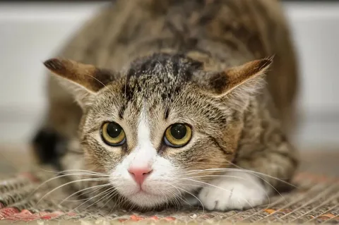
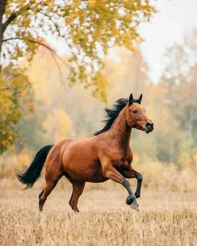
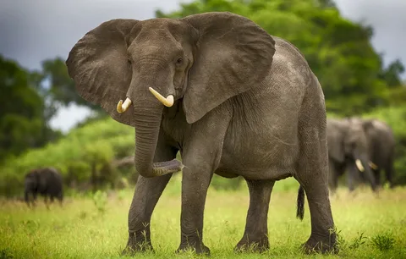
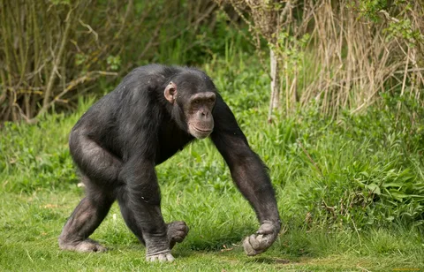
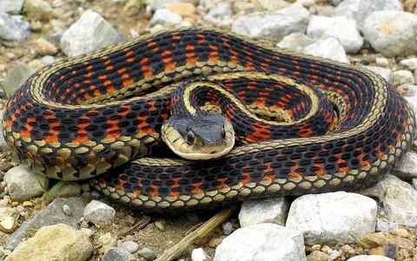
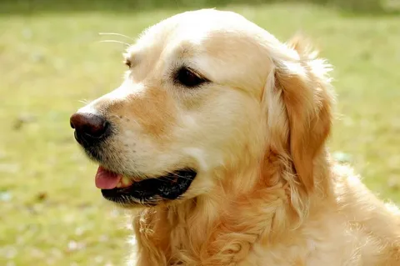
Let’s play
Show me an animal.

Slide 23
Match
1 Have you got a pet? | A It’s black.
2 What’s its name? | B No, it isn’t.
3 How old is it? | C Murka.
4 Is it big? | D Yes, I have.
5 What colour is it? | E 4 years old.
1 D 2 C 3 E 4 B 5 A

Slide 24


Slide 25

Ask and guess the animal
1 minute

Slide 27
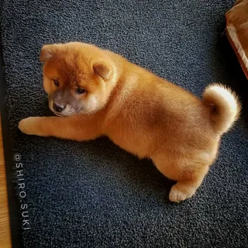
Read
This is my dog. Its name is Baikal. He is brown. He’s not big. He’s got a short tail, small ears and big eyes. I like Baikal.

